Slide 1

Connectivity DICOM - ISP
Archana
Medical Software Reg No. 111001006

Slide 2
Agenda
Overview Of Hospital Workflow
Overview of Radiology workflow – inline with portal
What Is Philips IntelliSpace Portal ?
Connectivity
DICOM
Project Phases & Testing
DICOM testing
Work Done
Additional work
Learning's
References

Slide 3
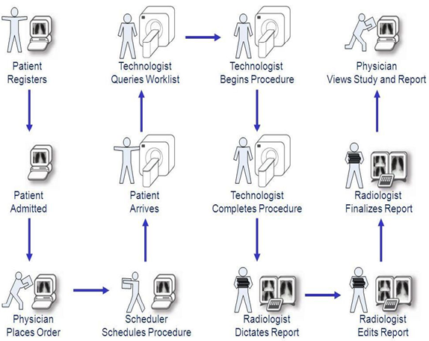
Overview Of Hospital workflow

Slide 4
Overview of Radiology workflow – inline with portal

Slide 5
What Is Philips IntelliSpace Portal ?
A Workstation Software on windows platform.
Enterprise product providing integrated clinical solutions :
that’s multimodality (CT,NM,MR and US), and multivendor.
Offers Advanced Visualization diagnosis by:
Turning any PC into an advanced visualization platform.
Visualization software, 3D Tools.
Rich clinical applications :
access to more than 30 advanced clinical applications via a single workspace.
Powerful thin-client solution for Portability :
offers the flexibility to diagnose and collaborate virtually anytime/anywhere.
Work from preferred environment to analyze, manipulate & review locally.

Slide 6
Cont.…
Collaborative Workflow :
IntelliSpace Portal Web Collaborator, provides virtually instant access to
peers & specialists around the world by using a standard web browser.
Integration with PACS through Plug-in:
Interfaces for integration with Philips PACS and other vendors PACS through sever.
providing simplicity and scalability reducing the need to acquire multiple workstations by modality.
Philips award winning thin-client solution which is intuitive and easy-to-use has been ranked #1 by KLAS in its 2008 and 2010 “Top 20 Best in KLAS Awards: Software & Professional Services” for Advanced Visualization.
Easy to Access :
Increases flow of information between technologist, radiologist, referring physician and specialists helps improve patient care and increase
diagnostic confidence.

Slide 7
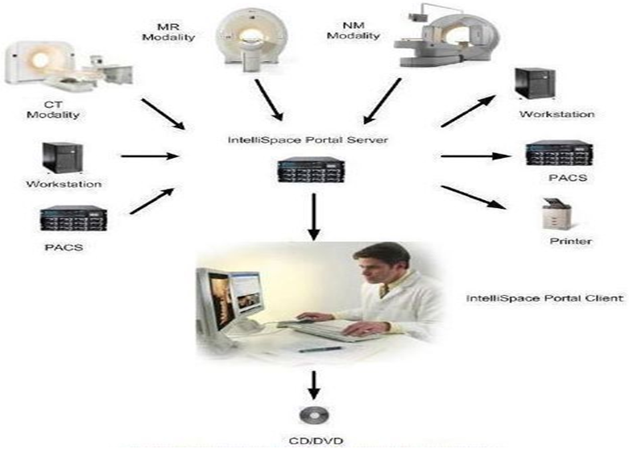
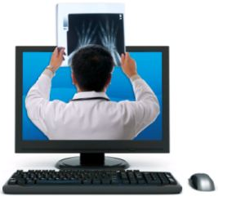
Fig.. Philips IntelliSpace in a DICOM network
Client 1
..…
..…
Client 15

Slide 8
Connectivity
Integrating all the medical devices.
through which data is transferred between a medical device, such as Archiving devices or workstations.
Interoperability is most important.
Interoperability is the ability of medical devices to seamlessly communicate with one another.

Slide 9
ICAP - System Verification Team
We are the Final Gate before the product gets into Market.
Entire Product is divided into below teams :
CT Apps
NM Apps
MR Apps
System & Platform Team

Slide 10
Project Phases & Testing
We are the Final Gate before the product gets into Market.
Beta1 -> Beta 2 -> Beta 3 -> Beta 4 ->RfLD ->RfVD.
The product goes through Below Phases Before Going to Market :
Integration Phase:
product is still in WIP.
Sub-System Phase:
It is a Functional Product.
TESTING PERFORMED
Integration
TESTING PERFORMED
Functional
Regression
Exploratory

Slide 11
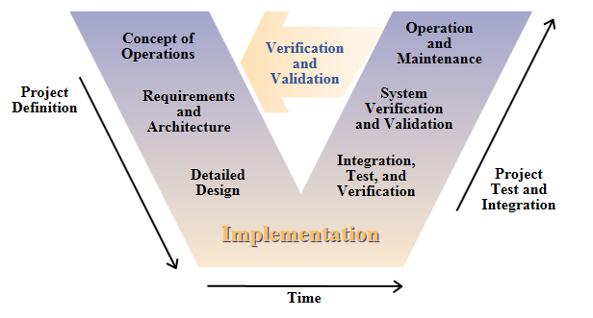
Cont.…
System Phase:
Enterprise product.
We follow iterative V - Model, software development life cycle model.
TESTING PERFORMED
Compatibility
Stress
Performance
Multi-Client

Slide 12
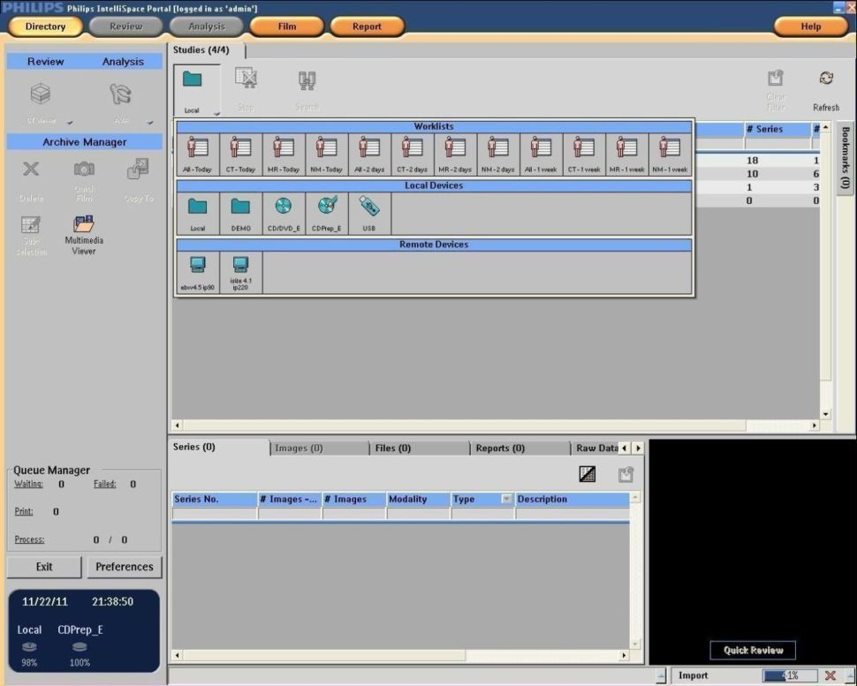

Patient Directory

Slide 13
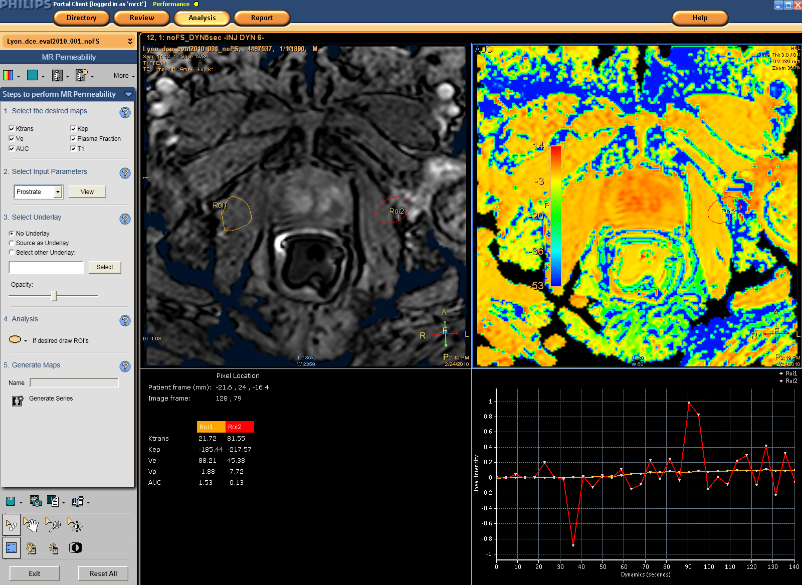
Fig.. Finding ROI by Applications

Slide 14
Work Done
Data Validation
Image Database & Rebuild
Removable Device[CD/DVD , USB, DVD-RAM]
Free Space & Auto Delete
Preferences
Multi Client Enterprise Aspects
Installation & Smoke Testing on ISO

Slide 15
Data Validation
Every image Supported & Created by portal is DICOM compliant.
Challenges :
Multi-Modality & Multi-Vendor Support(to create each & every o/p).
Run DVTK & Analyze the results with developer/interoperability teams.
Image Database & Rebuild
DB integrity check is a fast test that runs over the DB to verify that there are no problems
with it and in case there are it corrects it.
Bad Folder
Challenges :
Last accessed time.
Logs
Verification Check point.
Disk Space.

Slide 16
Removable Device[CD/DVD , USB, DVD-RAM]
Used for different purposes :
Record, store, analysis for, diagnosis in :
Hospital records/research/radiologist/clinicians/Patients.
Challenges :
Multi vendor, Multi-Speed disks & Hardware's in market.
DICOM viewer.
Generic test cases in past were removed and performed test case design.
Windows compatible operations Defects.
Connectivity as burning is done on the client while the original data is stored in server.
Free Space & Auto Delete
Portal automated task :
Maintain a continuous workflow.
Challenges :
Relevant data not been deleted.
User cannot tolerate a fully occupied database.
Planning [deletion mechanism, timing].
Verification Check point [No predefined values].
Recognitions : Spot Award.msg Appreciation.msg

Slide 17
Preferences
Allow each user to personalize how applications should
behave for his workflow.
Preferences is carried over when user logs in any machine.
Challenges :
To check if the user setting is retained has applied and not applied for others.
lack of definitions to testers.
Checks in Upgrade servers if configuration is correct.
Multi - Client Enterprise Aspects(15 Clients Support)
We Promise enterprise solutions between :
Departments.
Enterprise.
PACS(Plug-in).
Challenges :
System Performance & Stress.
System level thinking.
User Privileges.
System Connectivity.

Slide 18
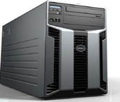

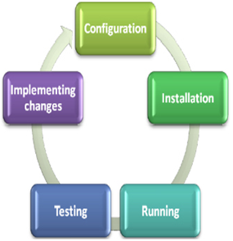
Installation & Smoke Testing on ISO
Weekly installation.
Upgrade from previous versions.
Challenges :
Verifying for broken release in upgrades.
Configurations & Connectivity.
Smoke testing for accepting the build for verification.
improves productivity.
avoids rework/re-testing.

Slide 19
Other Products
EBW 4.5
Portal 2.6
Isite PACS
Sectra PACS

Slide 20
Learning's
DICOM Standards
Software Test Life Cycle
Clinical Relevance to Imaging System
Traceability
Real World Requirements In Imaging Industry :
What was Previous workflow & What can be potential for Future ?

Slide 21
References
www.youtube.com/watch?v=gAfx9fzRzAQ
www.healthcare.philips.com/main/products/Solutions/IntelliSpaceportal
www.healthcare.philips.com/in/products
www.onestoptesting.com

Slide 22

Q & A

Slide 23

Thank You

